Slide 1

Application of Software Architecture Patterns for 2D Video Games
By: Felipe flores

Slide 2
Tables of Contents
Purpose & Overview
Main Task
Core Systems & Their Breakdowns
Software Architecture Patterns
Application of Software Architecture Patterns (Designs)
Technical Challenge
Conclusion

Slide 3

Purpose & Overview
Demonstrating how useful good software architecture patterns are when tackling complex problems.
To demonstrate this, I cover my own use of software architecture patterns when developing some core aspects of 2D video games.

Slide 4

Software Architecture
The high-level structure behind how code is organized
Involves a lot of diagrams
All to make a codebase easy to work with(encapsulation & communication)
It’s everywhere in programming (even if you ignore it)

Slide 5
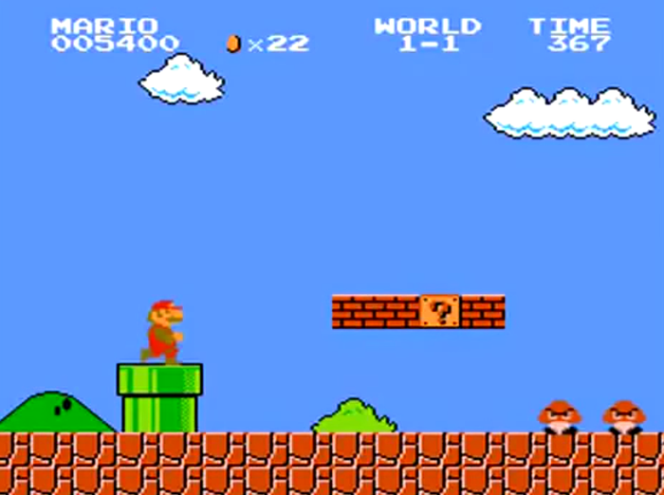
2D Video Games
Has a lot of parts to begin with
Needs a lot of communication between those parts
Gets out of hand without decoupling
Super Mario Bros – September 13, 1985 - Nintendo

Slide 6
Main Task
The development of 3 core systems of 2D video games (keeping scope manageable)
Research software architecture patterns to develop them
Apply the patterns into developing those 3 core systems
Draw.io is a free online diagram software
Unity Engine popular game engine used for the development of video games

Slide 7
My Chosen Core Systems of 2D Video Games
Player Controller
Enemy
HUD(Heads up Display)

Slide 8
Player Controller
Input- Needs to be able to detect user’s input
Movement- Needs to be able to move
Collision- Needs to able respond to the world around them

Slide 9
The Enemy
Detection- Needs to be able to detect the player
Movement- Needs to be able to move

Slide 10
The HUD
PlayerInfo(Health)- Needs to display the player’s health

Slide 11
Software Architecture Patterns
After I had defined these, I investigated what Software Architecture Patterns would be useful for developing these aspects such that they are easy to work with (read, expand upon)
Component Pattern
State Pattern
Observer Pattern

Slide 12
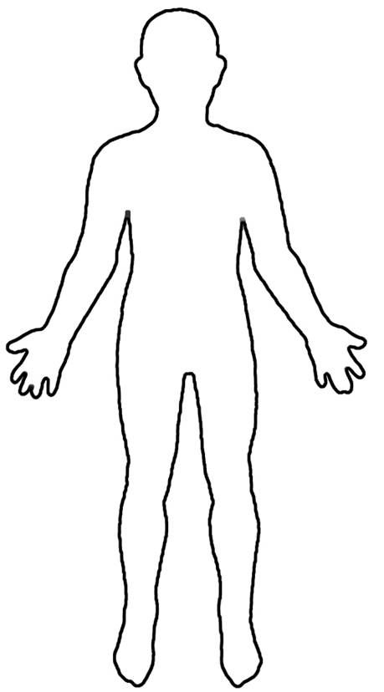
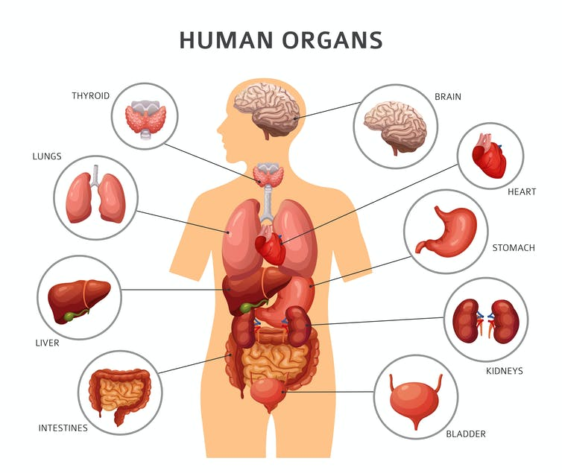
Component Pattern Info
The component pattern is best used for a single entity that spans multiple domains. Each domain is encapsulated in its own class, making up the components we will use.
Meanwhile, the entity itself becomes a container that simply brings all the components together.

Slide 13
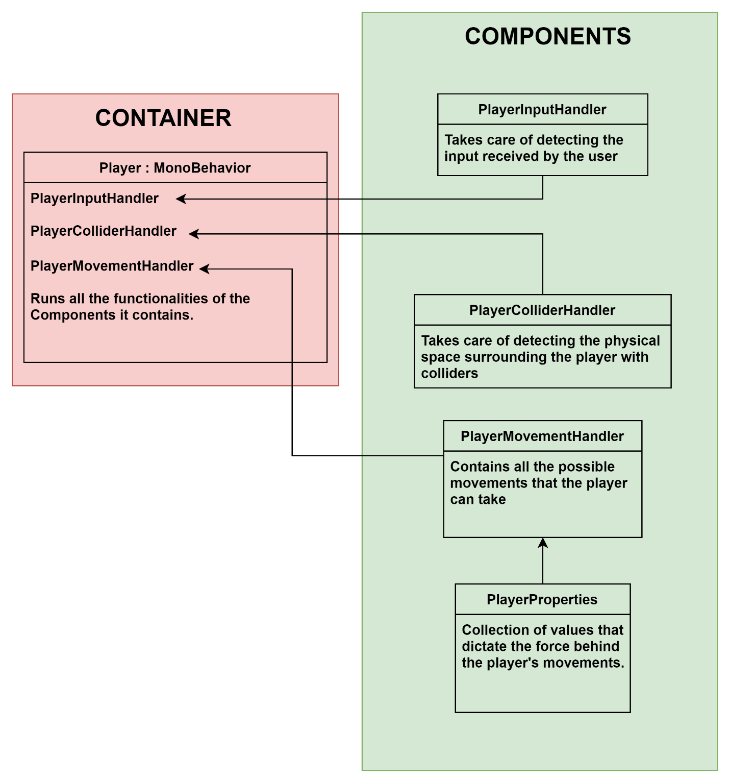
Component Pattern Application pt 1
Slicing up aspects of the player

Slide 14
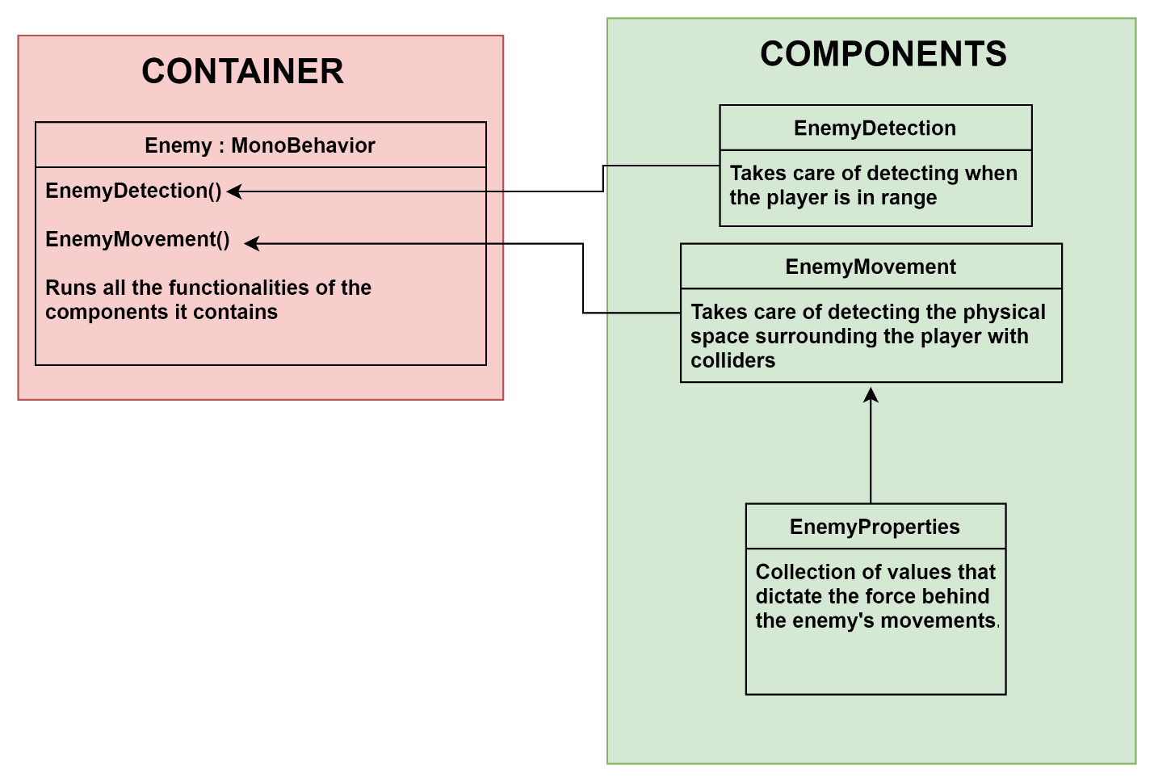
Component Pattern Application pt 2
Slicing up aspects of the enemy

Slide 15

Observer Pattern Info
The observer pattern defines a one-to-many dependencies between objects so when one object changes state, all of its dependencies are notified and updated automatically.
The observer pattern is best used when an object needs to receive an update on another object’s change and respond to said change accordingly
In the observer pattern, we define the nosy class that is interested in the change within another class as the observer. The class that has the change itself is defined as the subject

Slide 16
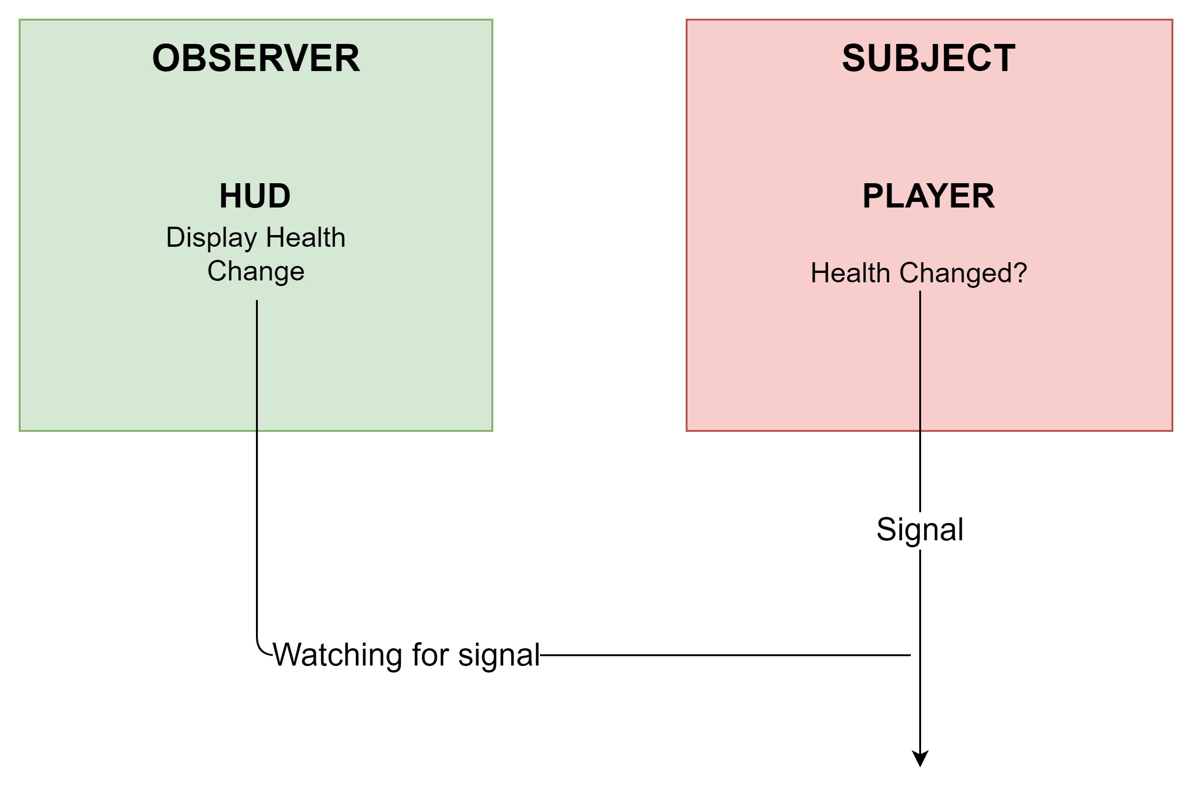
Observer Pattern Application
Assigning Observer & Subject

Slide 17
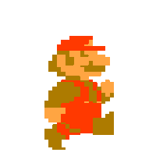
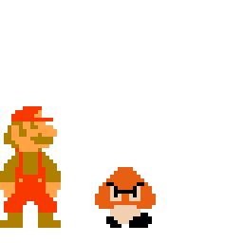
State Pattern Info
Allows an object to alter its behavior when it’s internal state changes.
It is best used for an entity whose behavior can change in response to a series of inputs overtime or in response to another entity
These behaviors must be easy to categorize into their own distinct classes
These distinct classes encapsulate each behavior, known as states

Slide 18
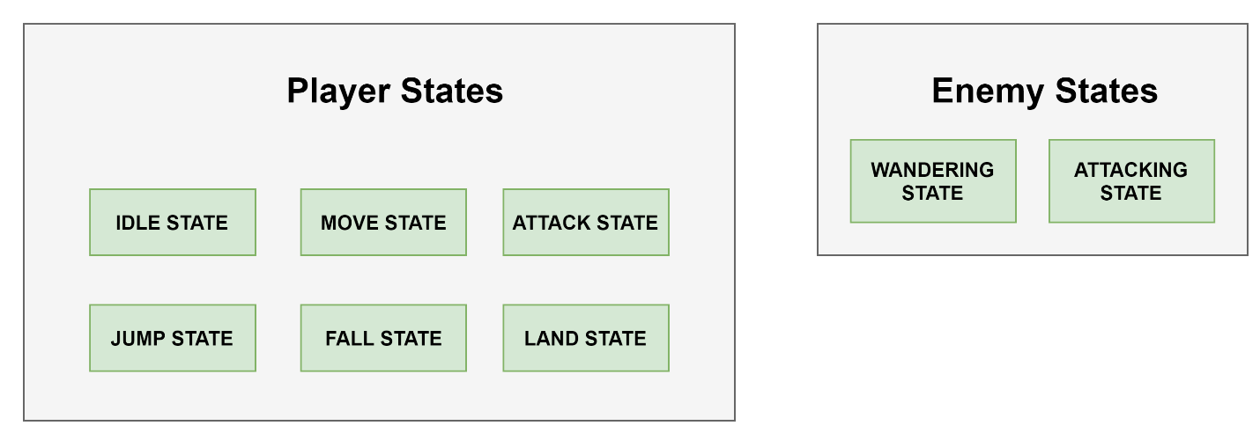
State Pattern Application pt 1
Encapsulation of behaviors for both Player and Enemy

Slide 19
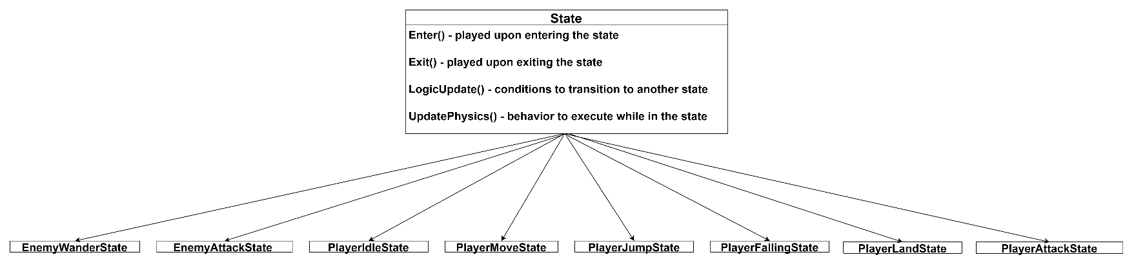
Implementation of States

Slide 20
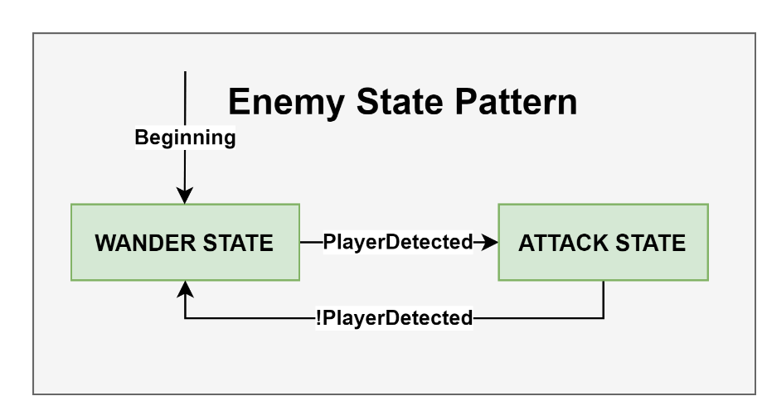
Enemy State Pattern Implementation

Slide 21
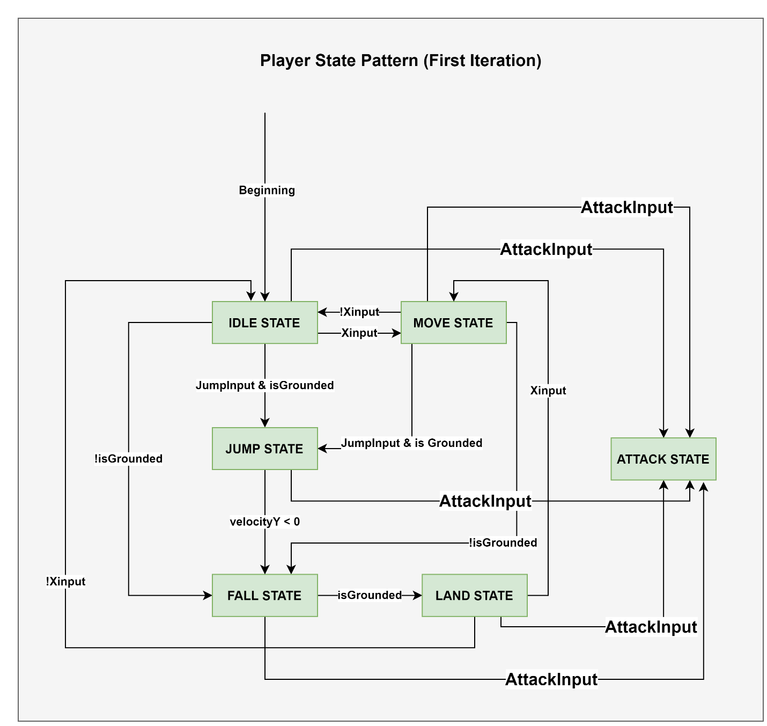
Player State Pattern Implementation

Slide 22
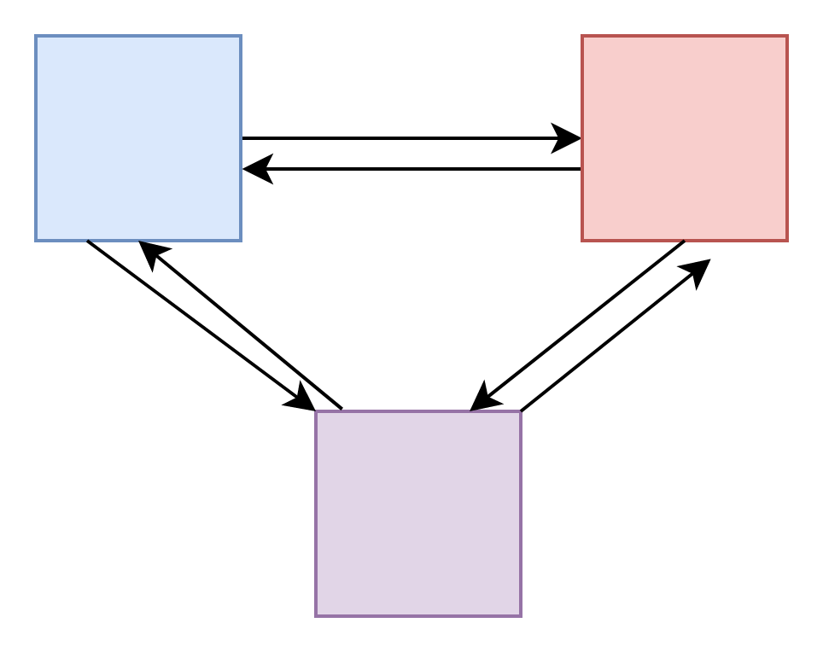
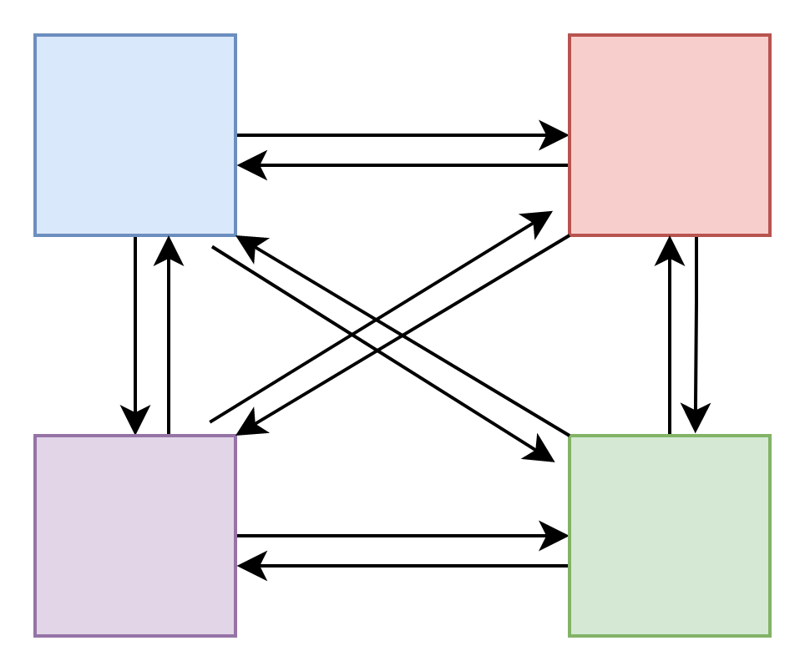
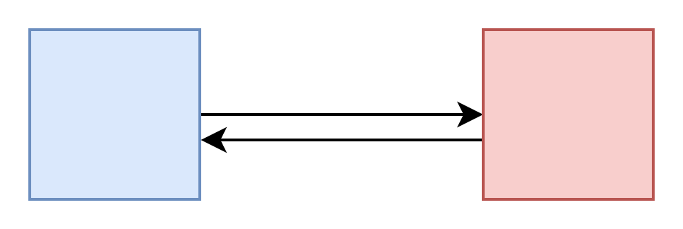

Slide 23
State Pattern Application…Complications
This…is undesirable
Adding more and more states rapidly increases the potential number of relationships we need to define
We need an improved State Pattern

Slide 24
Hierarchal State Pattern
Revising the player…
In this more advanced State Pattern, a state can have a superstate (making itself a substate), whose sole purpose is to define common transition conditions between a group of substates
This can be implemented by using inheritance

Slide 25
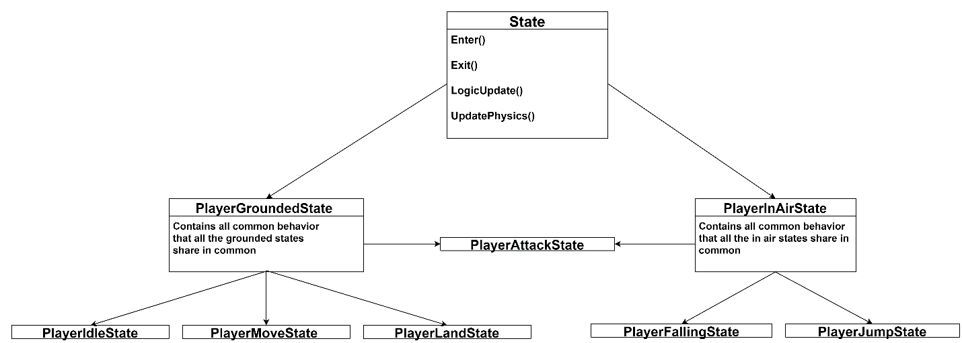
Re-Implementation of States

Slide 26
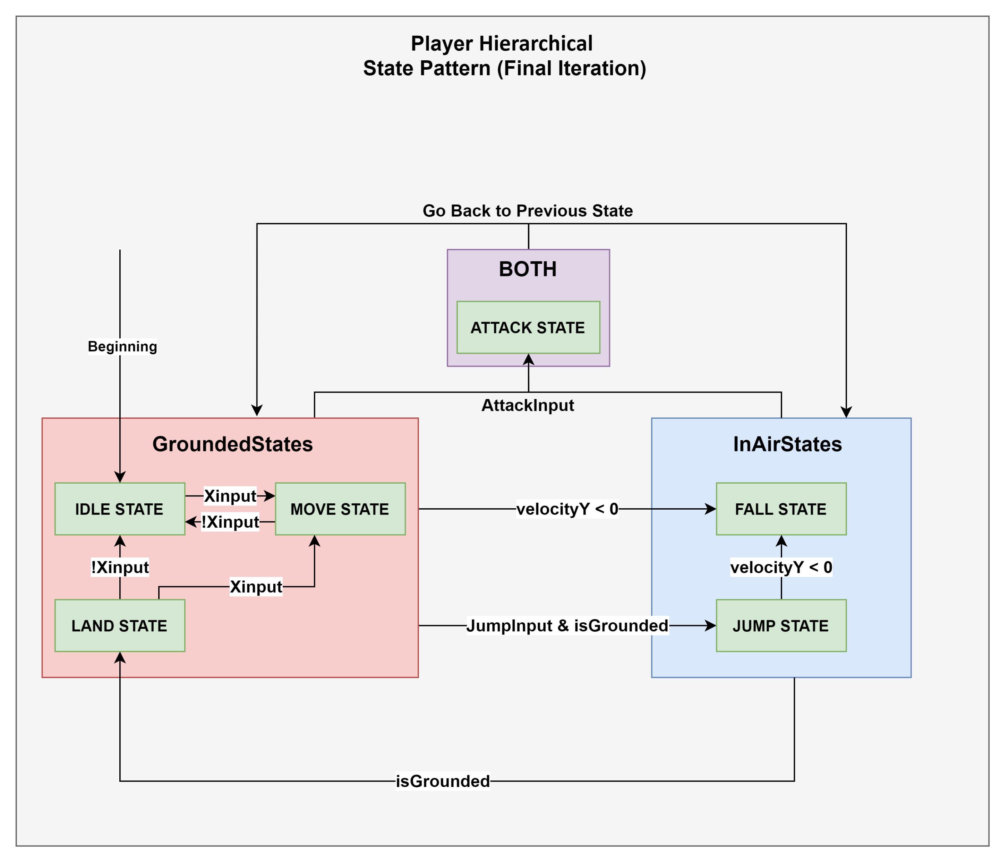
Player Hierarchal State Pattern (Final Iteration)

Slide 27
Conclusion
Software Architecture Patterns are useful for complex problems, of which are getting more and more prevalent in recent times
It is essential for young programmers to learn for a strong foundation in any codebase

